Slide 1
Website
User
Property
Flight
Restaurant
Airport Taxi
Booking
Listing

Slide 2
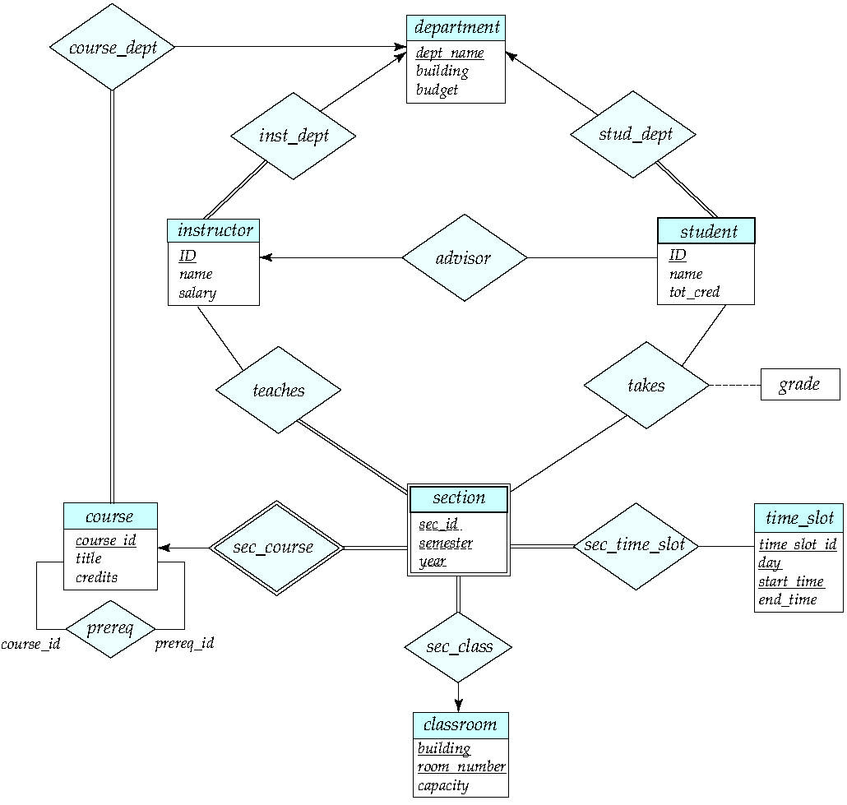
Customer
Customer
Customer
Customer
Customer
Supplier
Customer

Slide 3
Travel agency ER Model

